Slide 1
System Development Project
Course Code: CSE 3200
Submitted By
Emtias Ahamed
Roll: 1707089
Year: 3rd Term: 2nd
Arifur Rahman
Roll: 1707092
Year: 3rd Term: 2nd

Slide 2
Introduction & Objective
E-Commerce Website
We have developed an e-commerce website
in order to sell various kinds of Digital Gadgets.
Such as Mobile Phone, Smart Phone, Tab, Earphone, Headphone,
Charger, USB Cable, USB Converter, Power-bank etc.
This is for make the life of people easier a bit through make their online
order of various digital gadgets and
delivery to home during this locked down situation.

Slide 3
Environment & Tools
Used language: HTML5, CSS3, JS, PHP, Mysql
Framework: Jquery, Bootstrap4, Font Awesome
Database: phpmyadmin
API: Google Recaptcha V2, Map, SSLCommerz
Plugin: Facebook Page, Youtube Channel
Mailer: PHPmailer & SMTP
OS: Windows 10
Local Server: XAMPP

Slide 4
Overview And Description Of Website

Slide 5
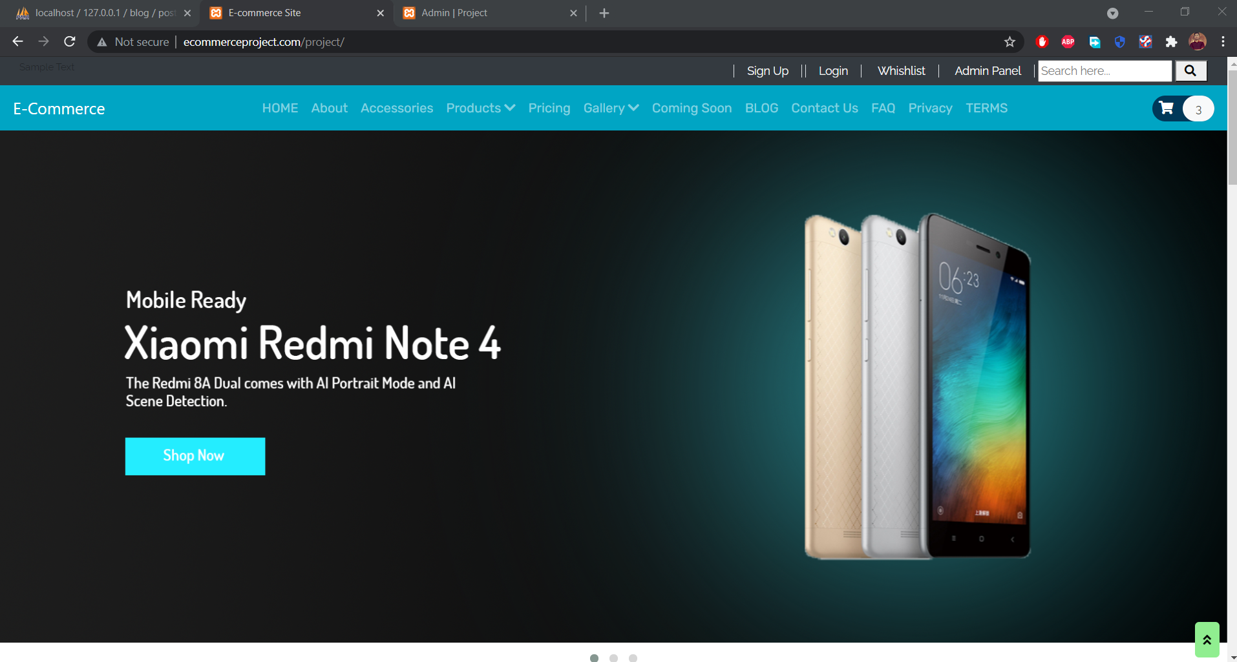
Home Page

Slide 6
Features:
Main Navigation Menu
Home
About
Gallery
Contact
FAQ, Terms & Privacy
User Registration
Sign Up
Log In
Enhance Security
Recovery A/C
Cart
Products
Payment Method
SSLCOMMERZ API
Payment success & Failure
Blog
User Sign Up
LogIn
Post
Facebook Comment PlugIn

Slide 7
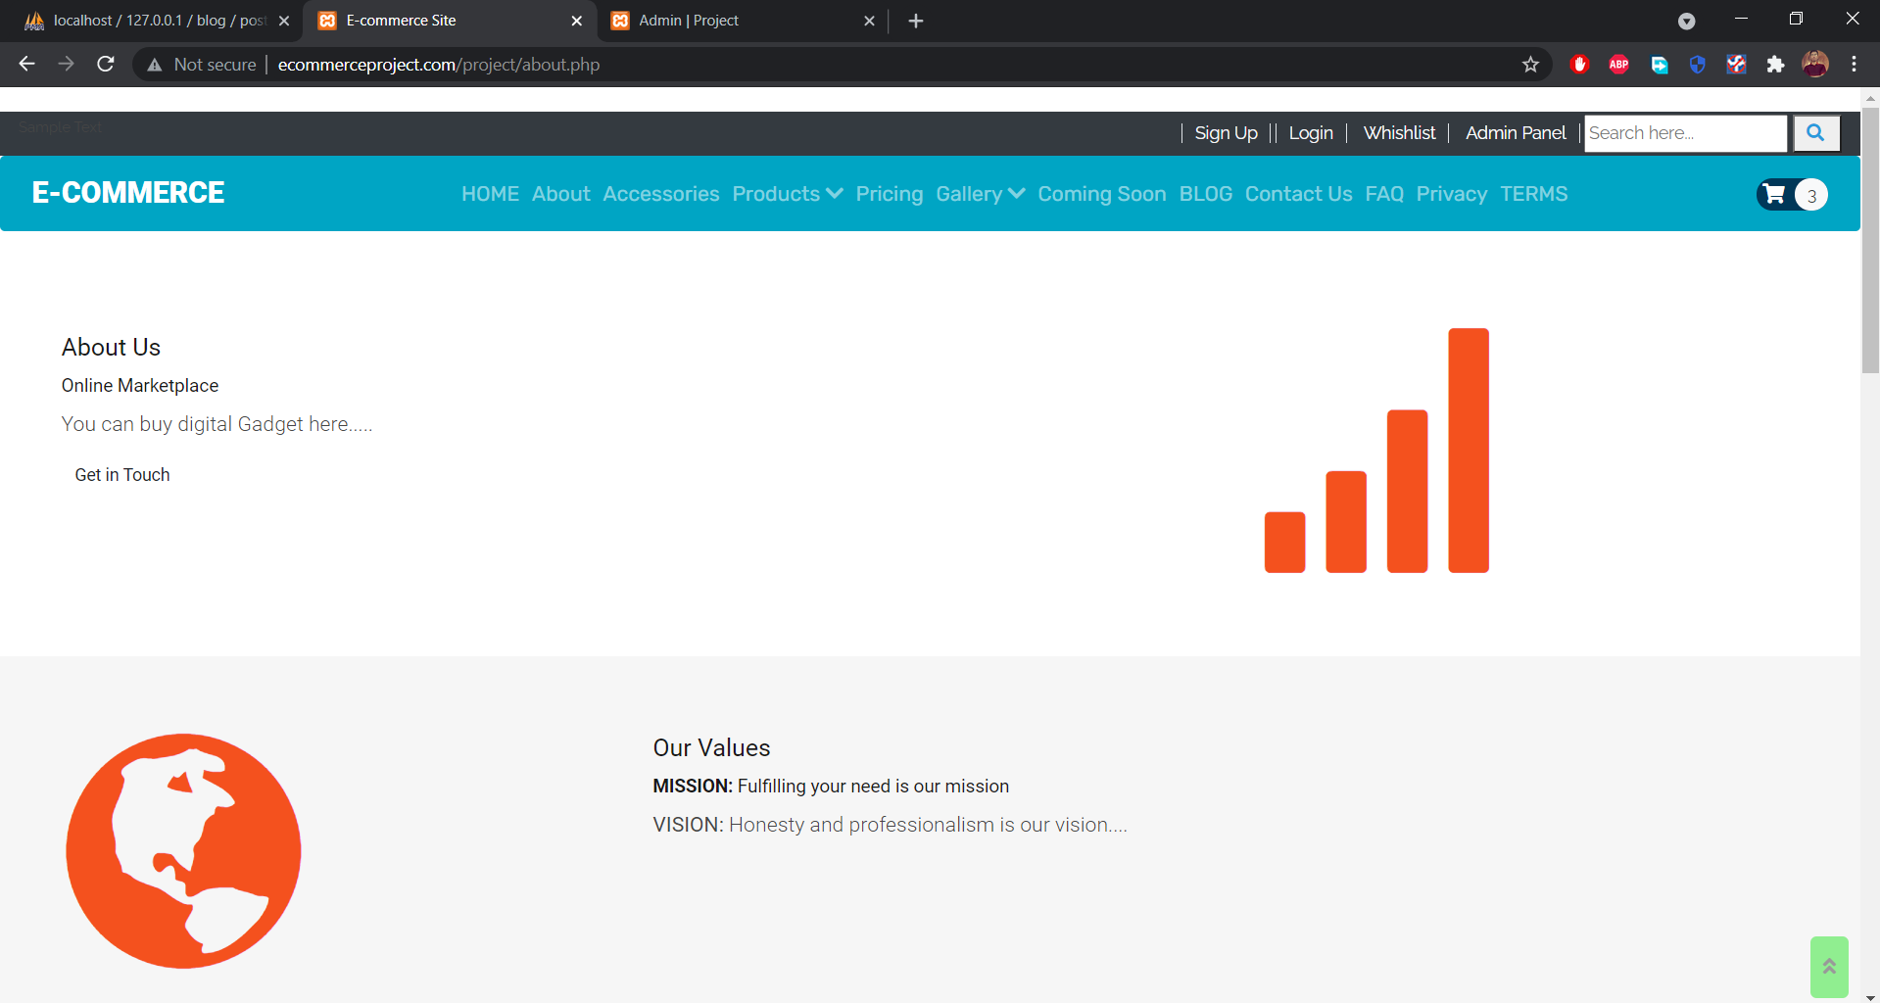
About

Slide 8
About
About Us
Mission & Vision
Our Team
Quick Links

Slide 9
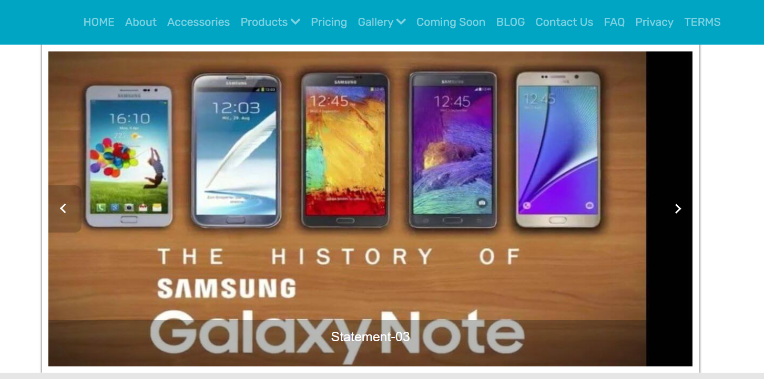
Gallery (Auto Move)

Slide 10
Contact Us
Customized Map
Responsive Contact Form
Youtube Plugin
Facebook Page PlugIn
Quick Links

Slide 11
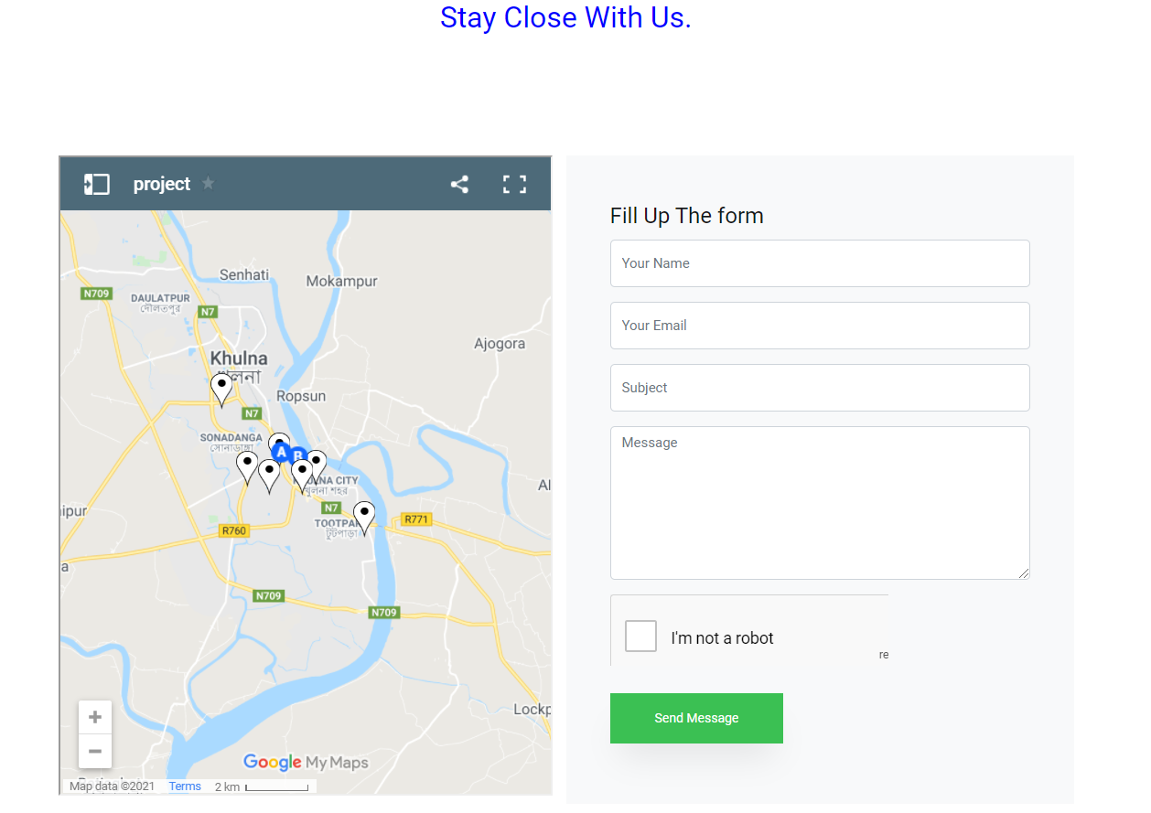
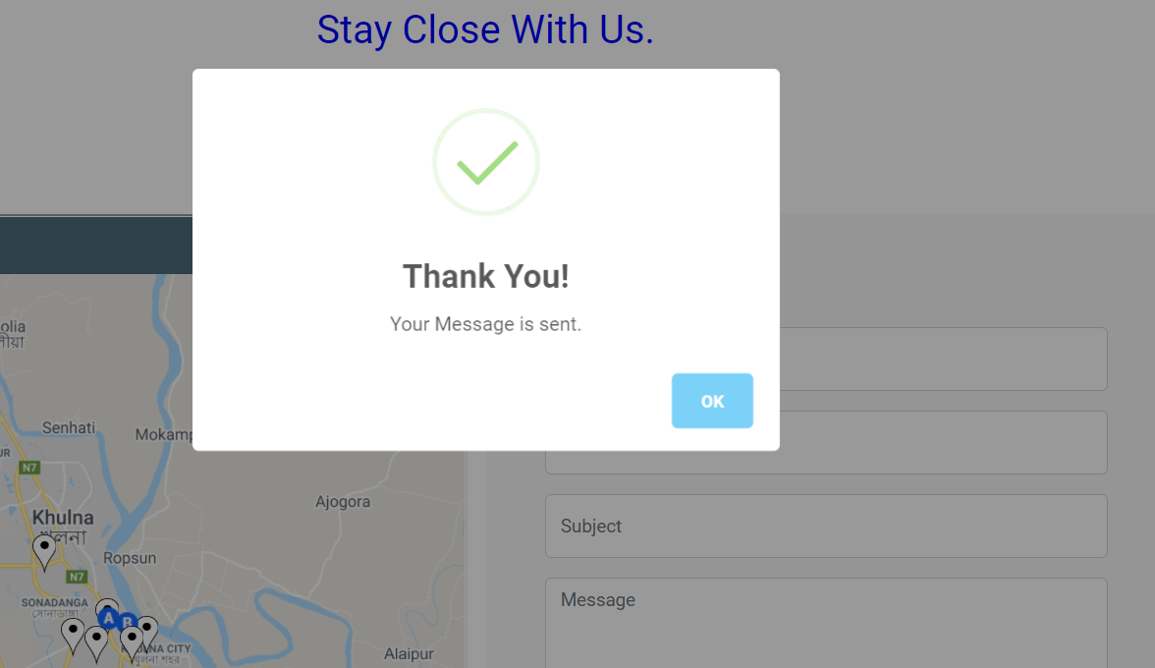
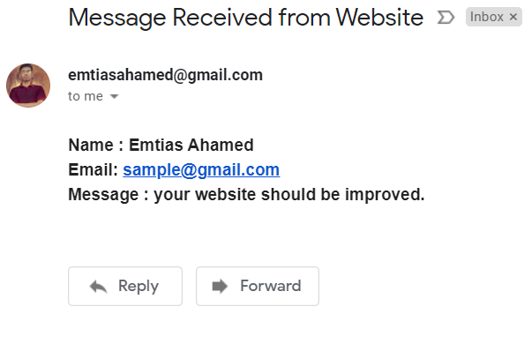
Contact Us

Slide 12
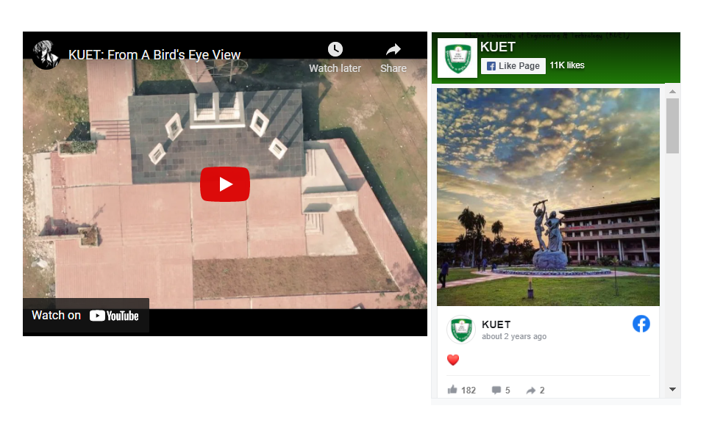
Contact Us

Slide 13
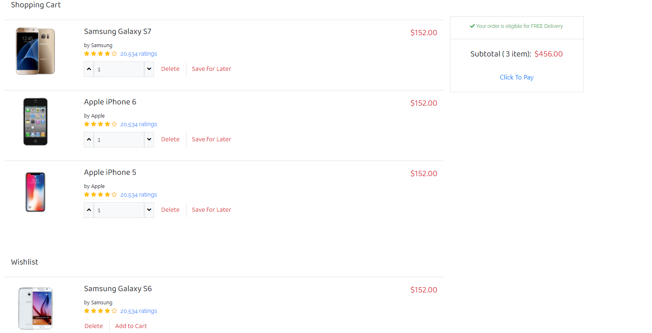
Cart & Wishlist

Slide 14
Cart & Wishlist
Products In Cart
Quantity Changeable
Wishlist
Total Charge
Click To Pay

Slide 15
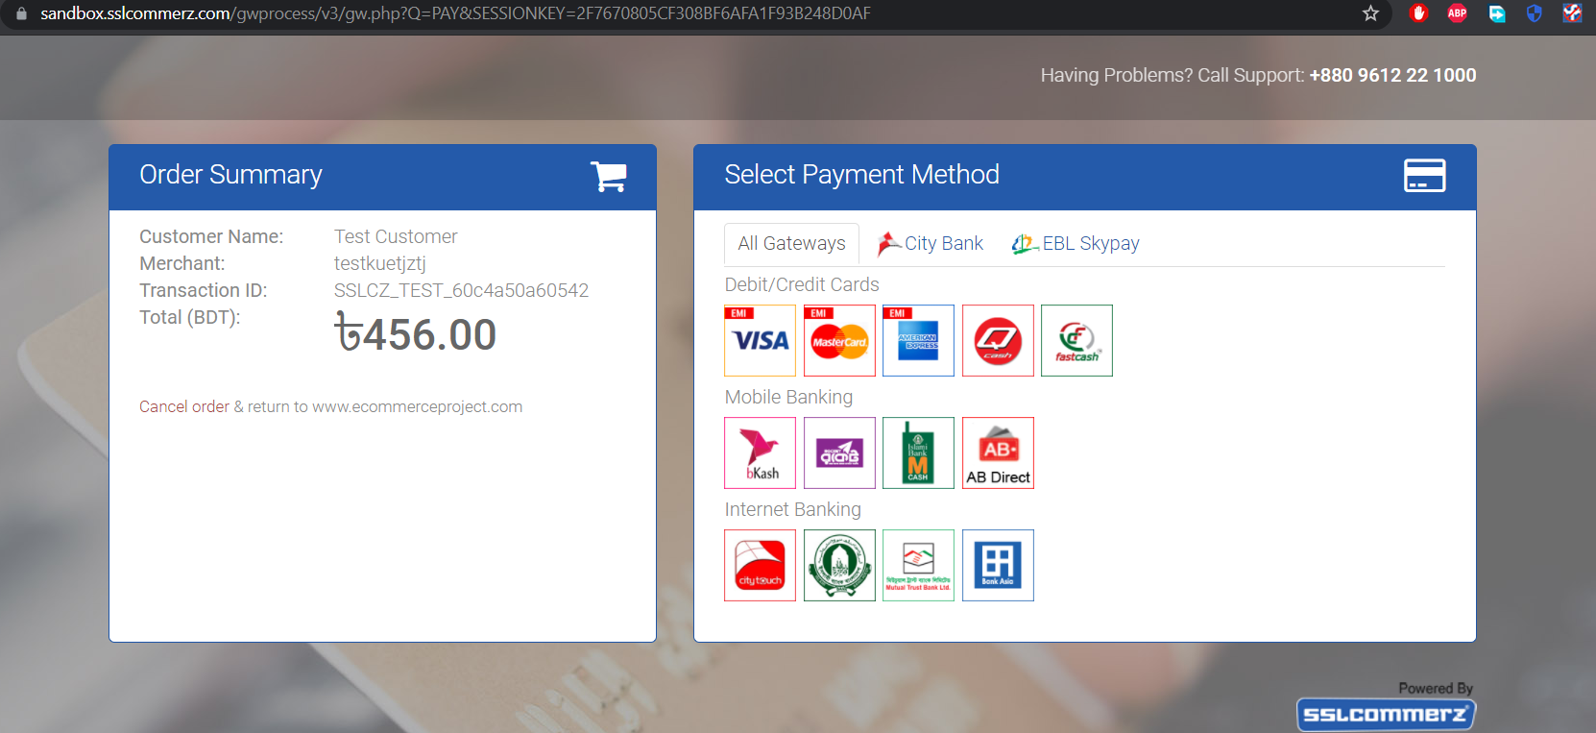
Payment Method

Slide 16
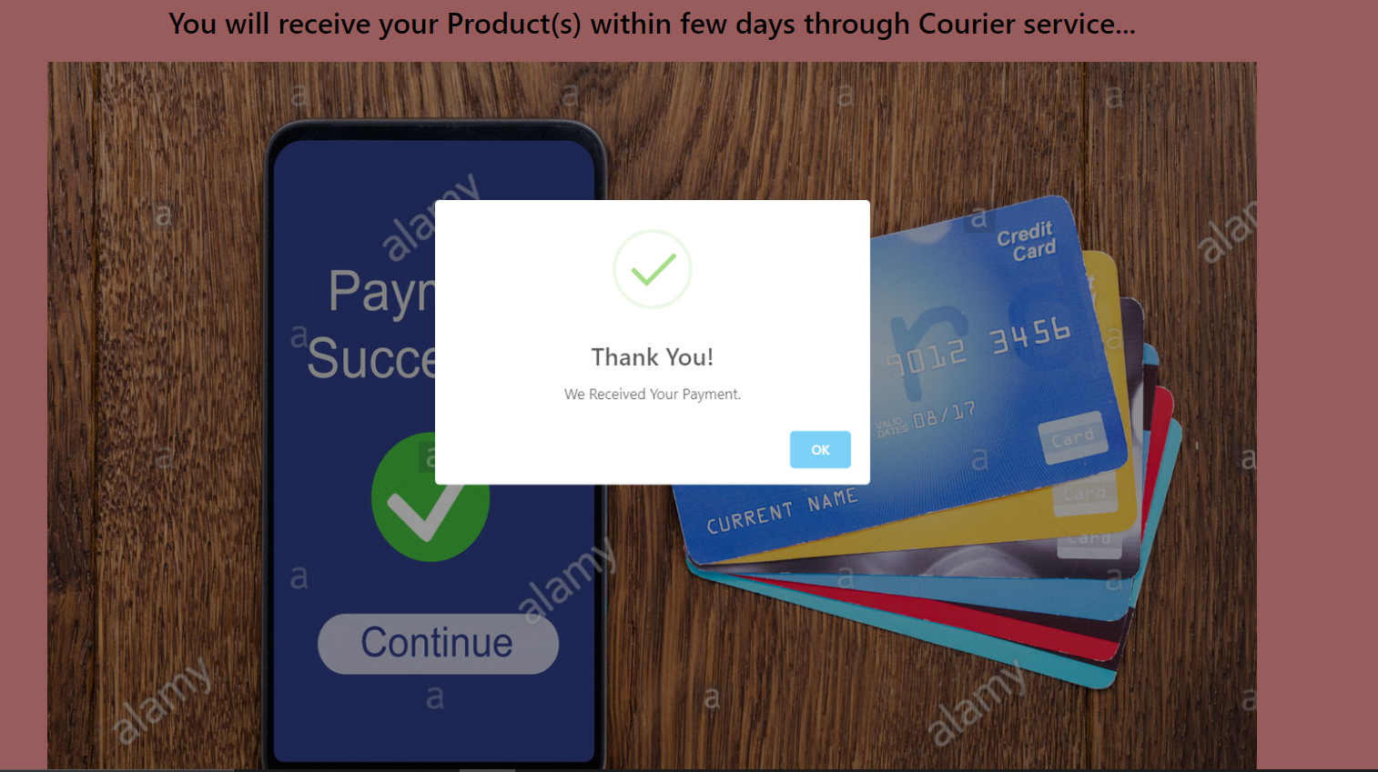
Successful Payment

Slide 17
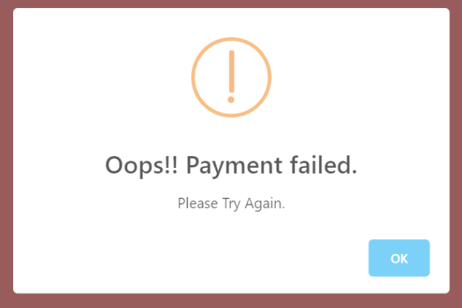
Payment Cancel/Incomplete
User will be notified if payment is not received

Slide 18
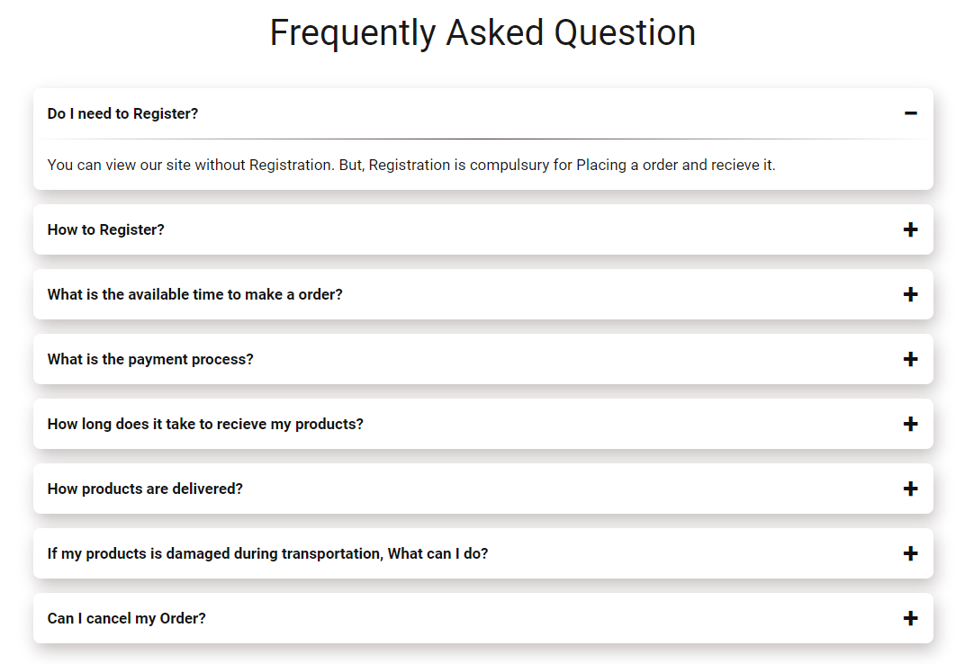
FAQ
(Expandable on Click)

Slide 19
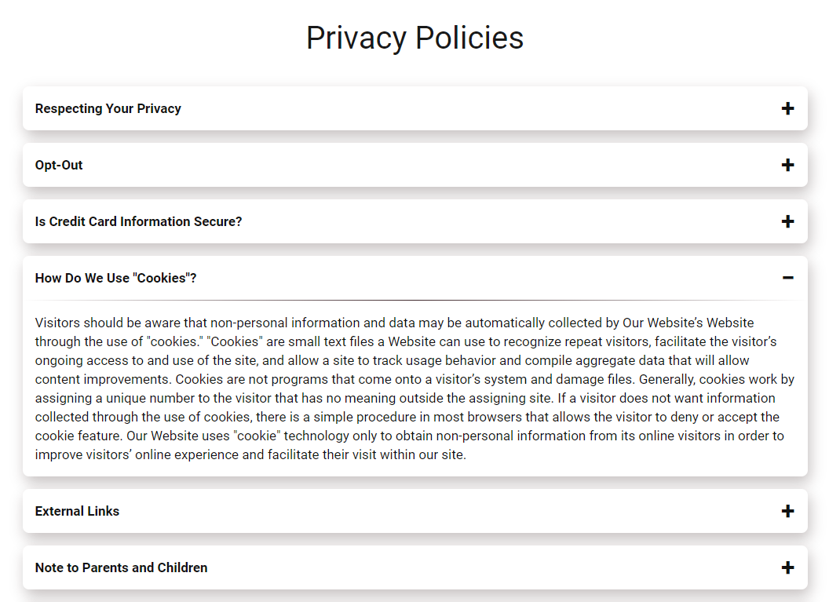
Privacy Policies
(Expandable on Click)

Slide 20
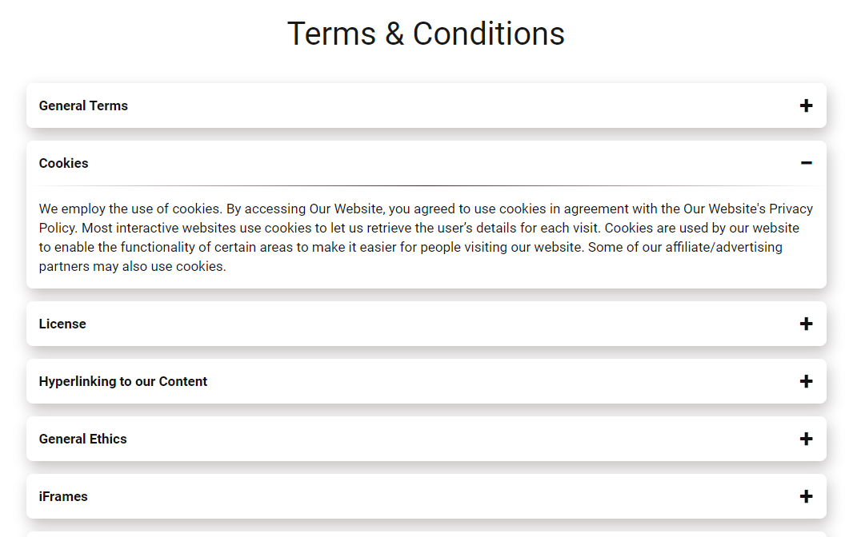
Terms & Condition
(Expandable on Click)

Slide 21
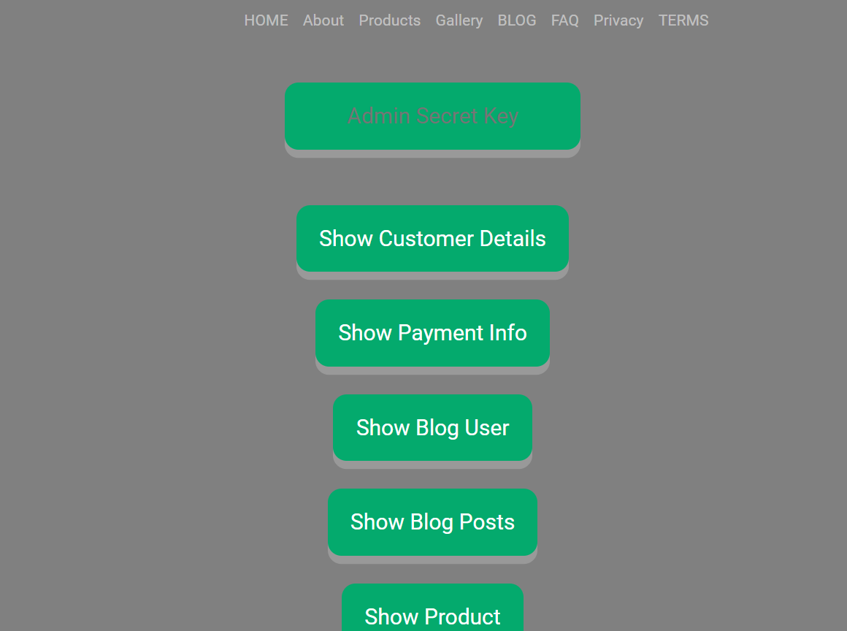
Admin Panel
Respective secret key should be entered

Slide 22
Admin Panel
Observation Of transaction Details
Add & delete specific product
Show Product
Observe Blog Users & Posts

Slide 23
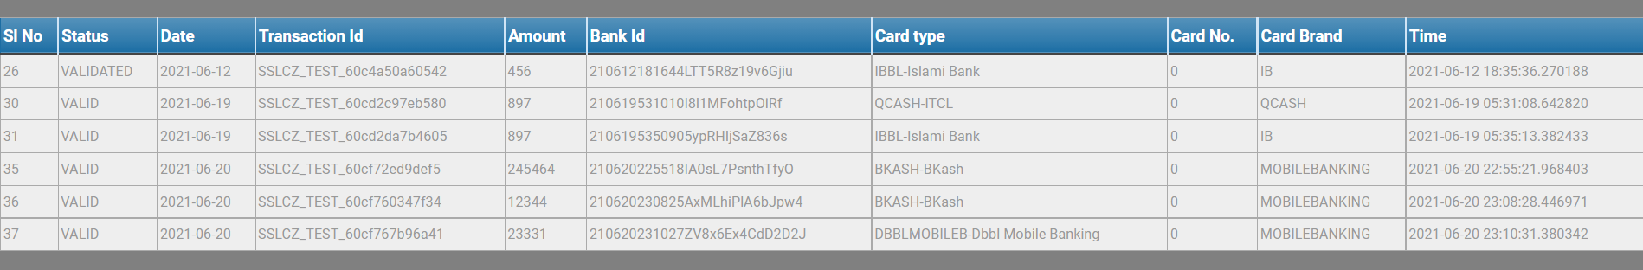
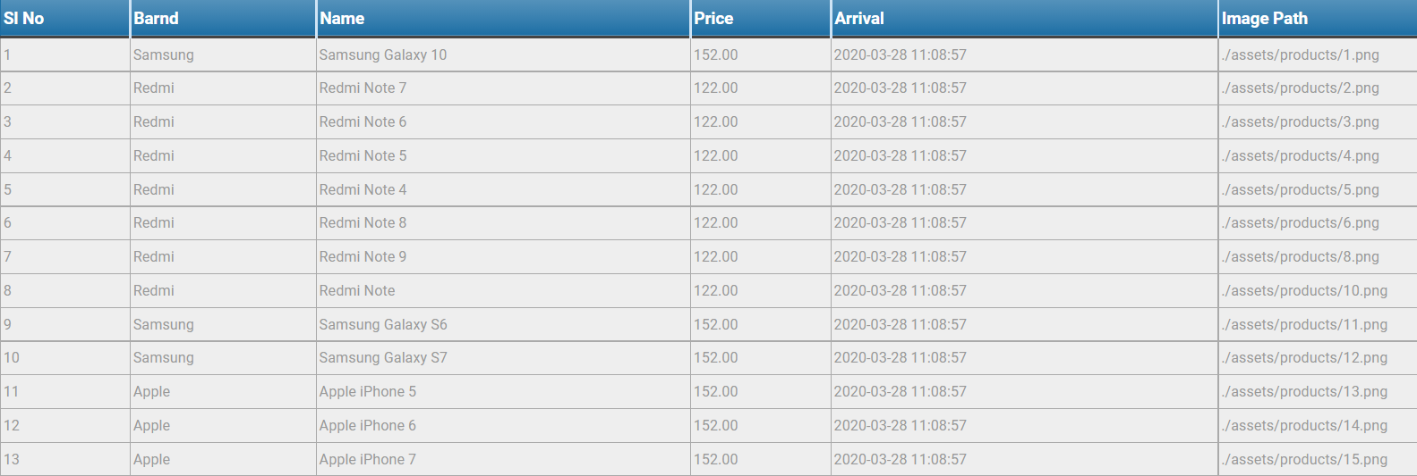
Payment info
Product Info

Slide 24
Contribution
Roll & Name | Work Field
1707089 Emtias Ahamed | FAQ, TERMS, Privacy Policies pages Contact Page (Using Mailer) Entire Payment System related segment Entire Admin Panel Google Recaptcha V2 Entire Blogging Site About page Presentation Slide Project Report
1707092 Md. Arifur Rahman | User Registration System (Sign Up, LogIn, 2 Factor Authentication, Log Out, Recovery) Home Page and Templates. Idea

